Slide 1
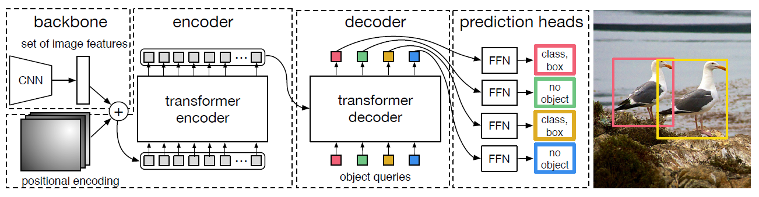

Slide 2
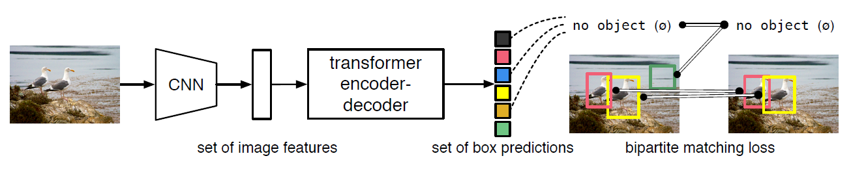

Slide 4
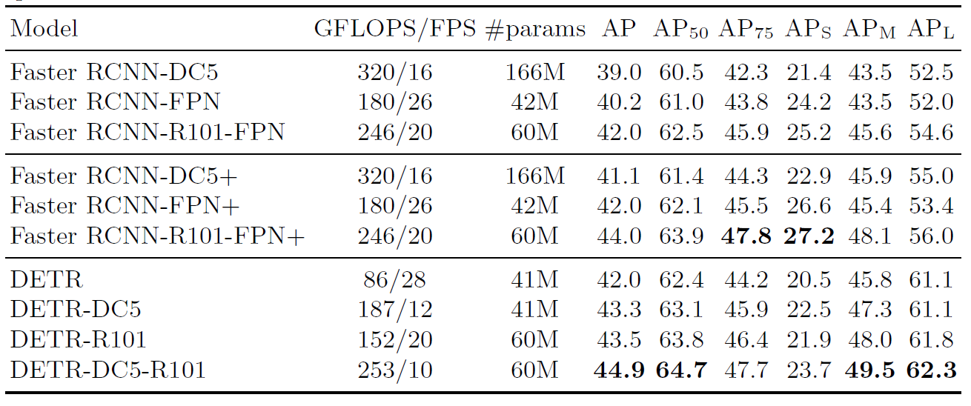

Slide 5
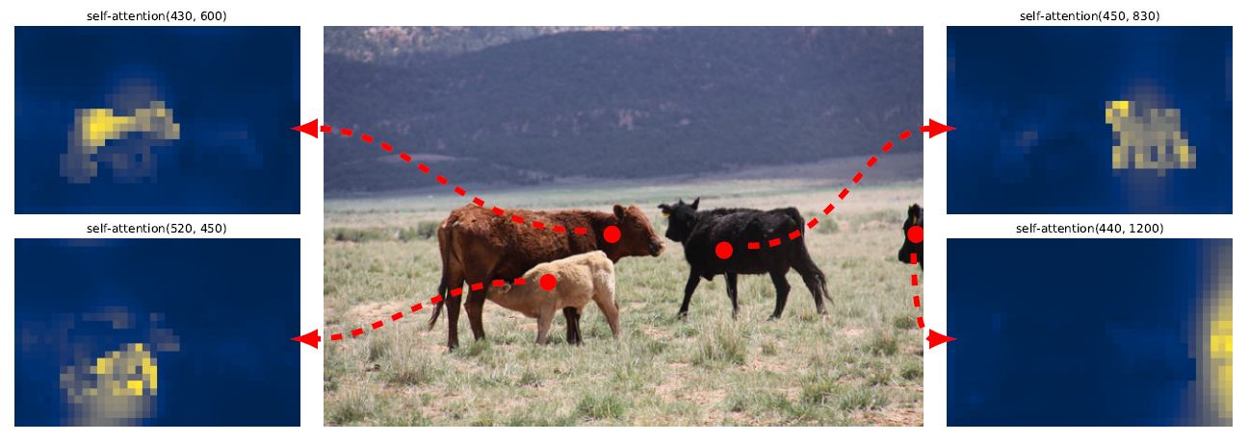

Slide 6
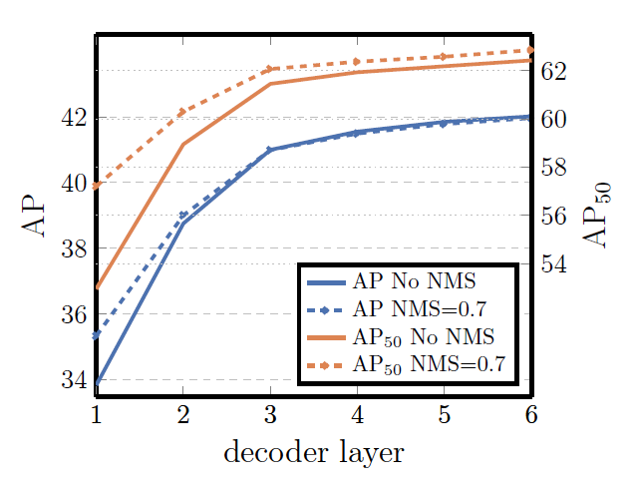

Slide 7
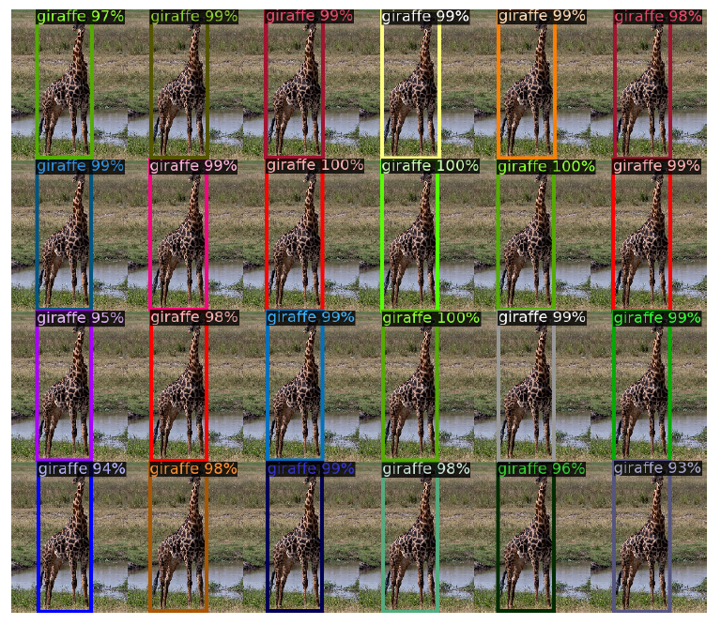

Slide 8
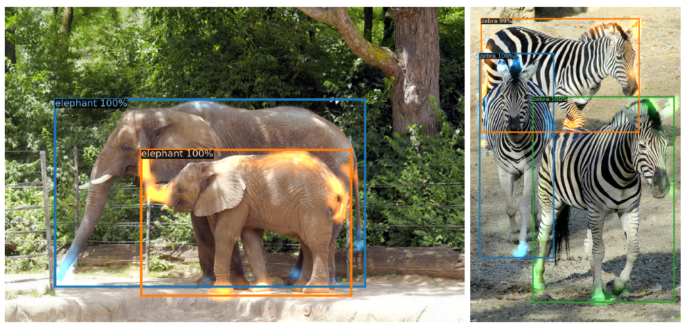

Slide 9
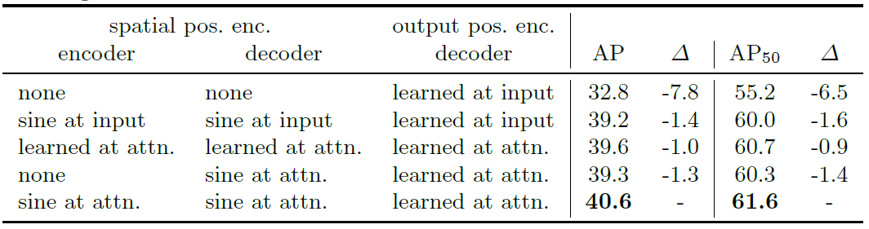

Slide 10
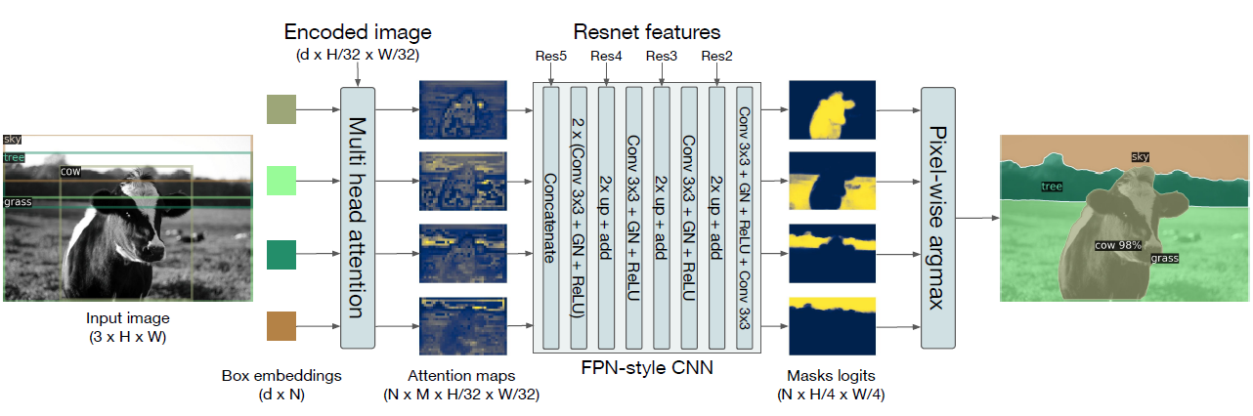

Slide 11
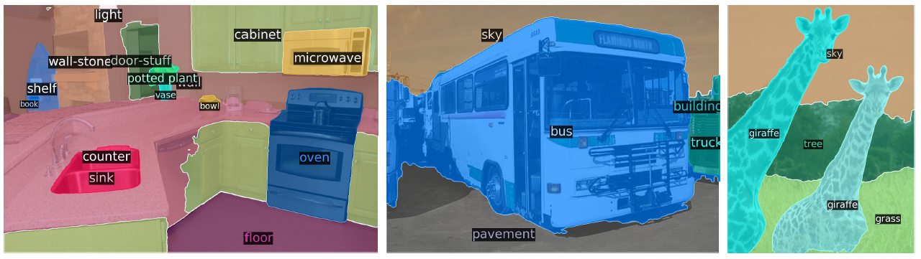

Slide 12
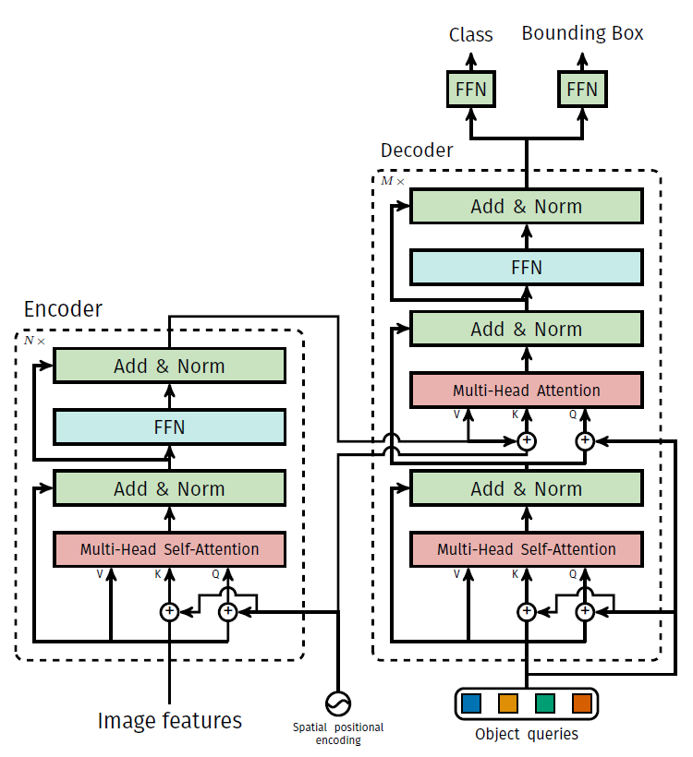

Slide 13
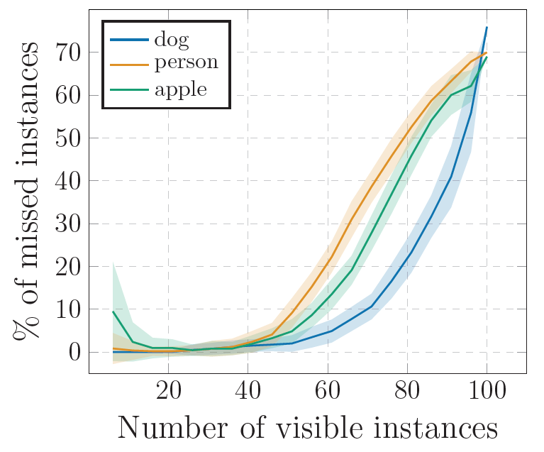

Slide 14
\sigma (y, \widehat{y}) = arg min\sum_{i}^{N}[-1_{c_{i}\neq \o }\widehat{p}_{\sigma(i)}(c_{i}) + 1_{c_{i}\neq \o}L_{iou}(b_{i}, \widehat{b_{\sigma(i)}})+1_{c_{i}\neq \o}\left \| b_{i}-\widehat{b_{\sigma(i))}} \right \|_{1}]
L(y, \widehat{y}) = \sum_{i=1}^{N}[-log \widehat{p}_{\sigma(i)}(c_{i}) + 1_{c_{i}\neq \o}L_{iou}(b_{i}, \widehat{b_{\sigma(i)}})+1_{c_{i}\neq \o}\left \| b_{i}-\widehat{b_{\sigma(i))}} \right \|_{1}]

